Slide 1
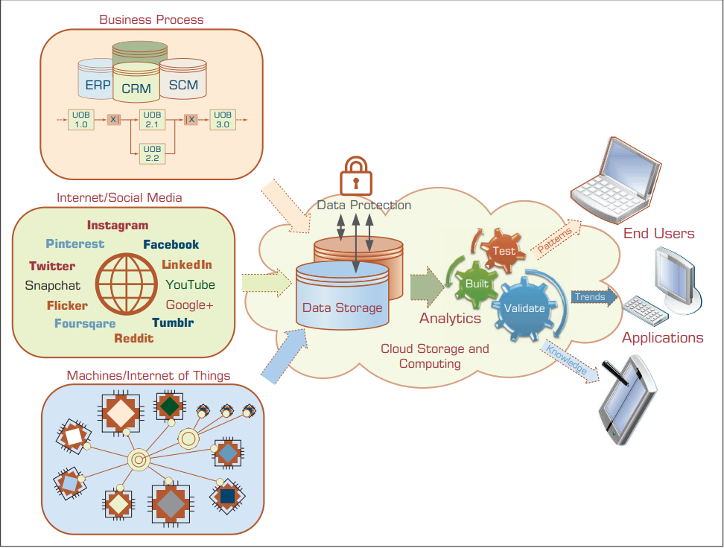
2.1 The Nature of Data
Data is the main ingredient for any BI, data science, and business analytics initiative. In fact, it can be viewed as the raw material for what these popular decision technologies produce—information, insight, and knowledge.

Slide 2
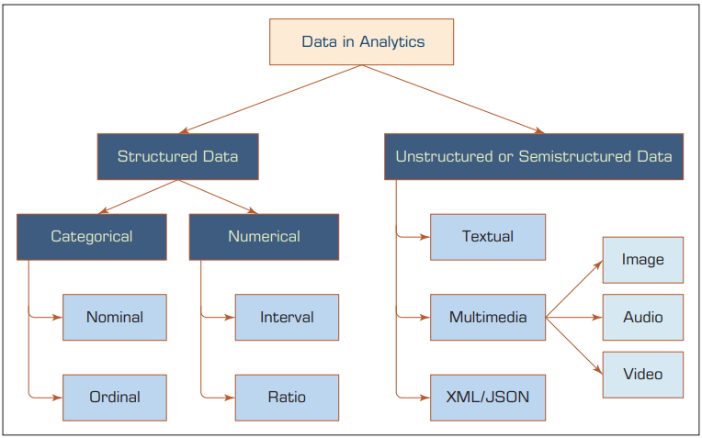
2.3 A Simple Taxonomy of Data
At the highest level of abstraction, one can classify data as structured and unstructured (or semi-structured).
Unstructured data/semi-structured data is composed of any combination of textual, imagery, voice, and Web content.
Structured data is what data mining algorithms use and can be classified as categorical or numeric.

Slide 3
>> Categorical data represent the labels of multiple classes used to divide a variable into specific groups.
Example. Categorical variables include race, sex, age group, and educational level.
Nominal data contain measurements of simple codes assigned to objects as labels, which are not measurements.
Example. Generally categorized as (1) single, (2) married, and (3) divorced. Nominal data can be represented with binomial values having two possible values (e.g., yes/no, true/ false, good/bad), or multinomial values having three or more possible values (brown/green/blue, white/black/Latino/Asian, Single/Divorced).
Ordinal data contain codes assigned to objects or events as labels that also represent the rank order among them.
Example. categorized as (1) low, (2) medium, or (3) high. Similar ordered relationships can be seen in variables such as age group (i.e., child, young, middle-aged, elderly) and educational level (i.e., high school, college, graduate school).

Slide 4
>> Numeric data represent the numeric values of specific variables.
Example. of numerically valued variables include age, number of children, total household income (in U.S. dollars), travel distance (in miles), and temperature (in Fahrenheit degrees).
Numeric values representing a variable can be integer (taking only whole numbers) or real (taking also the fractional number).
The numeric data may also be called continuous data, implying that the variable contains continuous measures on a specific scale that allows insertion of interim values.
Interval data are variables that can be measured on interval scales.
Example. Interval scale measurement is temperature on the Celsius scale.
Ratio data include measurement variables commonly found in the physical sciences and engineering. Mass, length, time, plane angle, energy, and electric charge are examples of physical measures that are ratio scales.

Slide 5
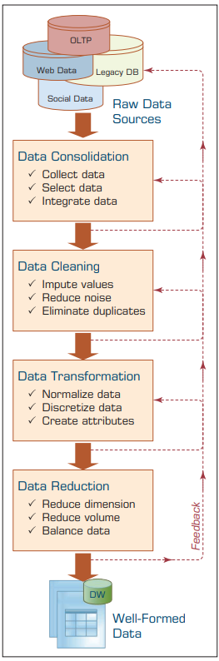
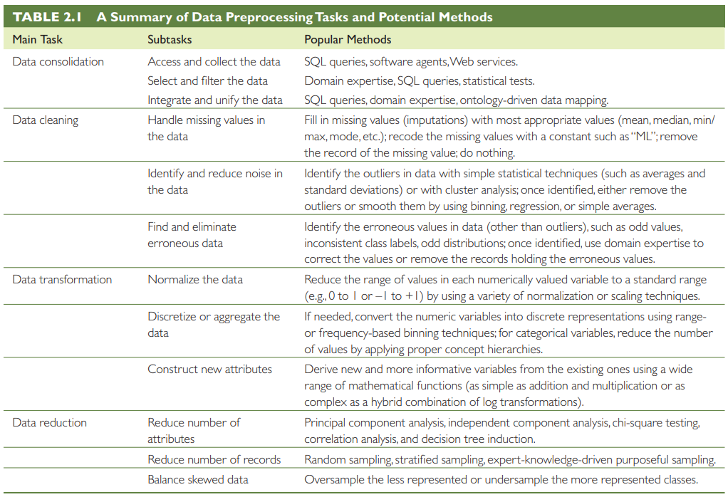
2.4 The Art and Science of Data Preprocessing

Slide 6
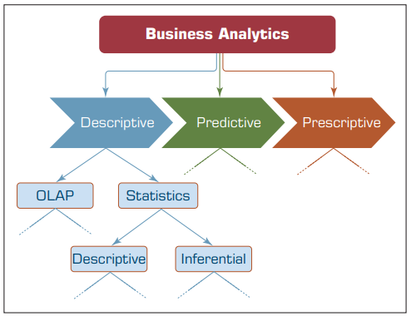
2.5 Statistical Modeling for Business Analytics

Slide 7
2.6 Regression Modeling for Inferential Statistics
Regression, especially linear regression, is perhaps the most widely known and used analytics technique in statistics.
As popular as it is, essentially, regression is a relatively simple statistical technique to model the dependence of a variable (response or output variable) on one (or more) explanatory (input) variables.
Regression can be used for one of two purposes:
hypothesis testing—investigating potential relationships between different variables.
prediction/forecasting—estimating values of a response variables based on one or more explanatory variables.

Slide 8
Difference between Correlation and regression
Applications of both Correlation and regression
Examples of both Correlation and regression

Slide 9
Simple versus Multiple Regression
If the regression equation is built between one response variable and one explanatory variable, then it is called simple regression.
Example. the regression equation built to predict/explain the relationship between a height of a person (explanatory variable) and the weight of a person (response variable) is a good example of simple regression.
Multiple regression is the extension of simple regression where the explanatory variables are more than one.
.
Example. in the previous example, if we were to include not only the height of the person but also other personal characteristics (e.g., BMI, gender, ethnicity) to predict the weight of a person, then it is called multiple regression analysis.

Slide 10
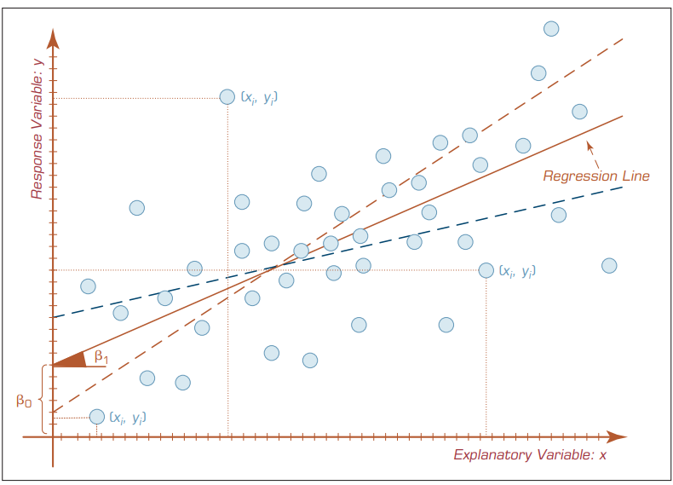
Even though there are several methods/algorithms proposed to identify the regression line, the one that is most commonly used is called the ordinary least squares (OLS) method.

Slide 11
Important example to understand the Model.
For example, it can be used to predict the relationship between reckless driving and the total number of road accidents caused by a driver, or, to use a business example, the effect on sales and spending a certain amount of money on advertising.
Regression is one of the most common models of machine learning.

Slide 12
How Do We Know If the Model Is good enough?
Sometimes models as representations of the reality do not prove to be good. Regardless of the number of explanatory variables included, there is always a possibility of not having a good model.
In the simplest sense, a well-fitting regression model results in predicted values close to the observed data values.
For the numerical assessment, three statistical measures are often used in evaluating the fit of a regression model.
R² (R-squared)
the overall F-test
the root mean square error (RMSE)
All three of these measures are based on the sums of the square errors (how far the data are from the mean and how far the data are from the model’s predicted values).

Slide 13
Of the three:
R² has the most useful and understandable meaning because of its intuitive scale.
The value of R² ranges from zero to one (corresponding to the amount of variability explained in percentage) with zero indicating that the relationship and the prediction power of the proposed model is not good, and one indicating that the proposed model is a perfect fit that produces exact predictions (which is almost never the case).
The good R² values would usually come close to one, and the closeness is a matter of the phenomenon being modeled.
For example. whereas an R² value of 0.3 for a linear regression model in social sciences can be considered good enough, an R² value of 0.7 in engineering may be considered as not a good-enough fit.

Slide 14
What Are the Most Important Assumptions in Linear Regression?
(self study)
Linearity
Independence
Normality
Constant variance
Multicollinearity

Slide 15
Logistic Regression
Logistic regression (LR) is a very popular, statistically sound, probability-based classification algorithm that employs supervised learning. It has been used extensively in numerous disciplines, including the medical and social sciences fields.
LR differs from linear regression with one major point: its output (response variable) is a class as opposed to a numerical variable. LR is used to classify a categorical variable.
Even though the original form of LR was developed for a binary output variable (e.g., 1/0, yes/no, pass/fail, accept/reject), the present-day modified version is capable of predicting multiclass output variables (i.e., multinomial LR).
In predictive analytics, LR models are used to develop probabilistic models between one or more explanatory/predictor variables (which may be a mix of both continuous and categorical in nature) and a class/response variable (which may be binomial/binary or multinomial/multiclass)

Slide 16
2.7 Business Reporting
Decision makers are in need of information to make accurate and timely decisions.
Information is essentially the contextualization of data. In addition to statistical means, information (descriptive analytics) can also be obtained using online analytics processing [OLTP] systems.
Business reporting (also called OLAP or BI) is an essential part of the larger drive toward improved, evidence-based, optimal managerial decision making.
The foundation of these business reports is various sources of data coming from both inside and outside the organization (online transaction processing [OLTP] systems).
Creation of these reports involves ETL (extract, transform, and load) procedures in coordination with a data warehouse and then using one or more reporting tools.

Slide 17
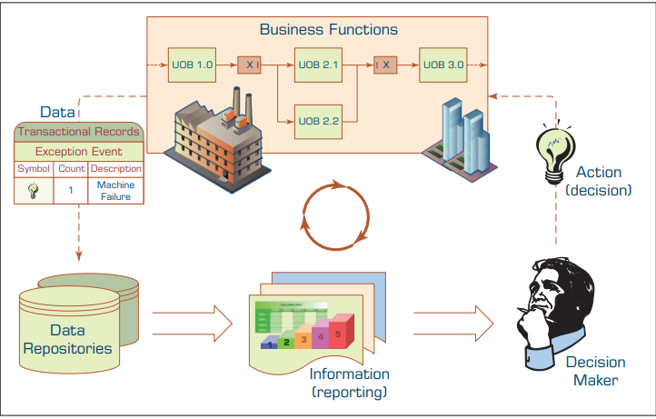

Slide 18
2.8 Data Visualization
Data visualization (information visualization) has been defined as “the use of visual representations to explore, make sense of, and communicate data”. Although the name that is commonly used is data visualization, usually what is meant by this is information visualization (IR).
Because information is the aggregation, summarization, and contextualization of data (raw facts), what is portrayed in visualizations is the information and not the data.

Slide 19
2.9 Different Types of Charts and Graphs
Self study

Slide 20
2.10 The Emergence of Visual Analytics
As Seth Grimes (2009a,b) has noted, there is a “growing palate” of data visualization techniques and tools that enable the users of business analytics and BI systems to better “communicate relationships, add historical context, uncover hidden correlations, and tell persuasive stories that clarify and call to action.”
In BI and analytics, the key challenges for visualization have revolved around the intuitive representation of large, complex data sets with multiple dimensions and measures.
For the most part, the typical charts, graphs, and other visual elements used in these applications usually involve two dimensions, sometimes three, and fairly small subsets of data sets. In contrast, the data in these systems reside in a data warehouse.
At a minimum these warehouses involve a range of dimensions (e.g., product, location, organizational structure, time), a range of measures, and millions of cells of data. In an effort to address these challenges, a number of researchers have developed a variety of new visualization techniques.

Slide 21
2.11 Information Dashboards
Information dashboards are common components of most, if not all, BI or business analytics platforms, business performance management systems, and performance measurement software suites.
Dashboards provide visual displays of important information that is consolidated and arranged on a single screen so that information can be digested at a single glance and easily drilled in and further explored.
Dashboard Design Dashboards are not a new concept.
According to Eckerson (2006), a well-known expert on BI in general and dashboards in particular has three layers of information:
Monitoring: Graphical, abstracted data to monitor key performance metrics.
Analysis: Summarized dimensional data to analyze the root cause of problems.
Management: Detailed operational data that identify what actions to take to resolve a problem

Slide 22
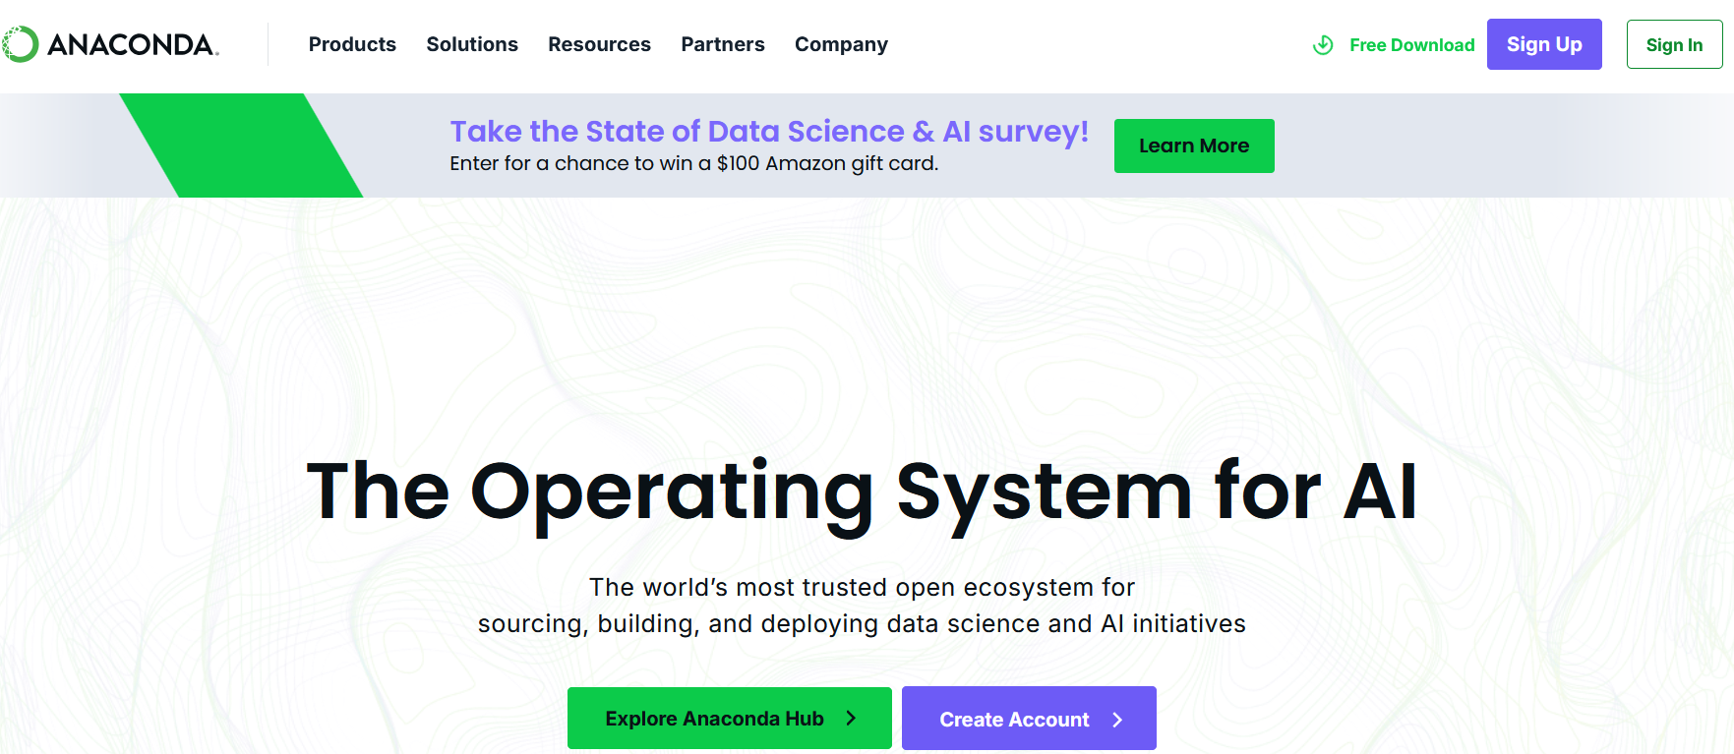
Go for Anaconda
Click the free download

Slide 23
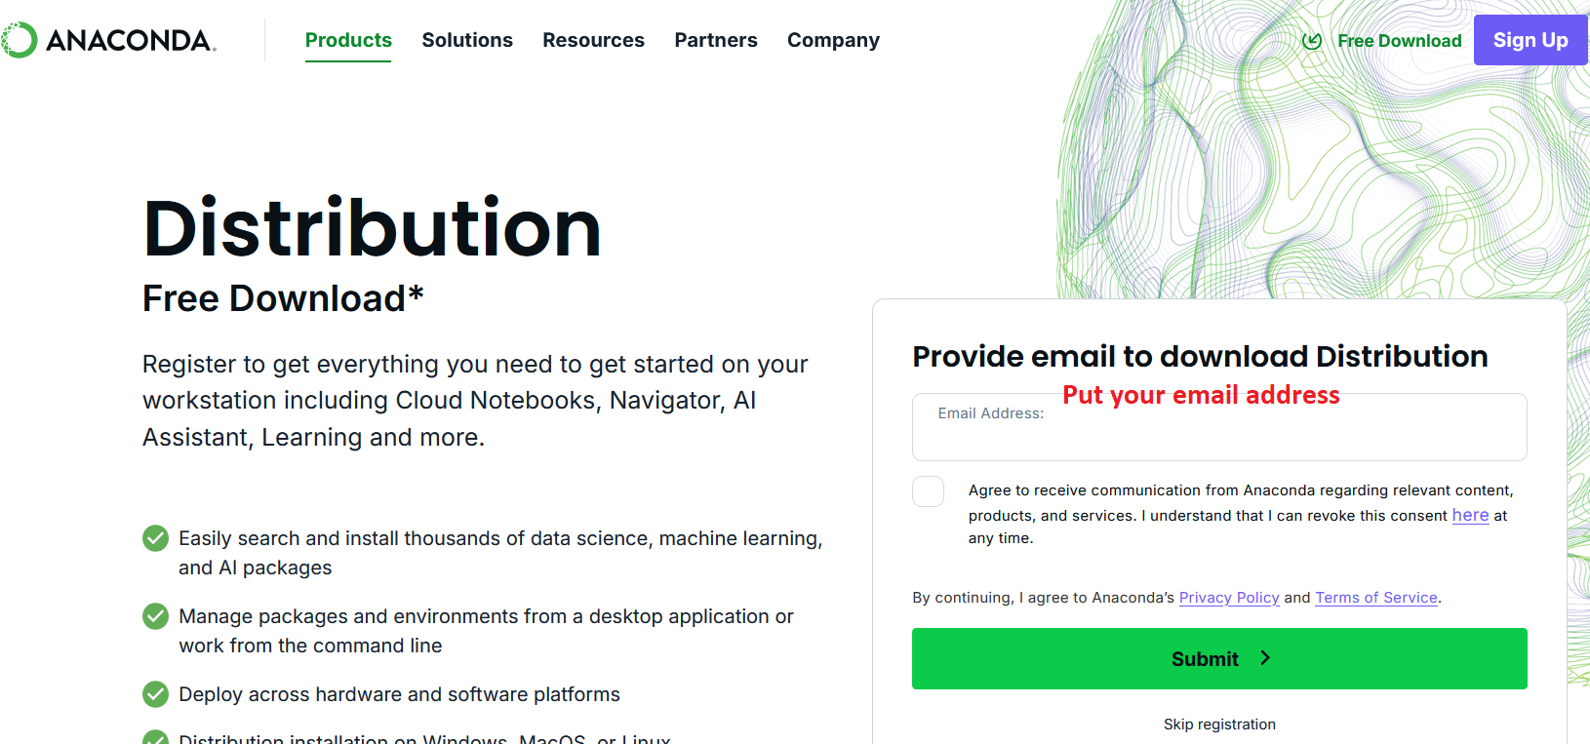

Slide 24
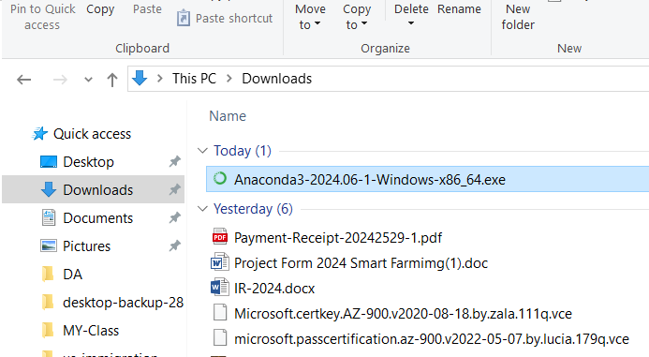
Go to email and click the link and go for download

Slide 25
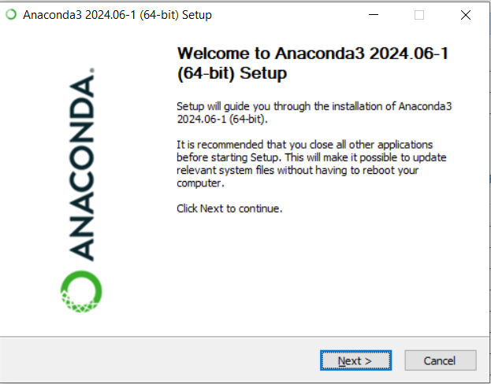

Slide 26
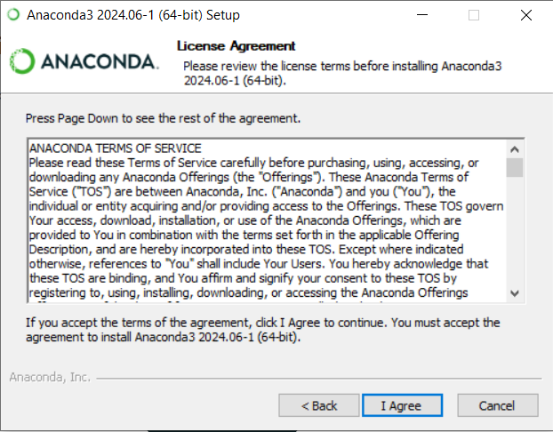
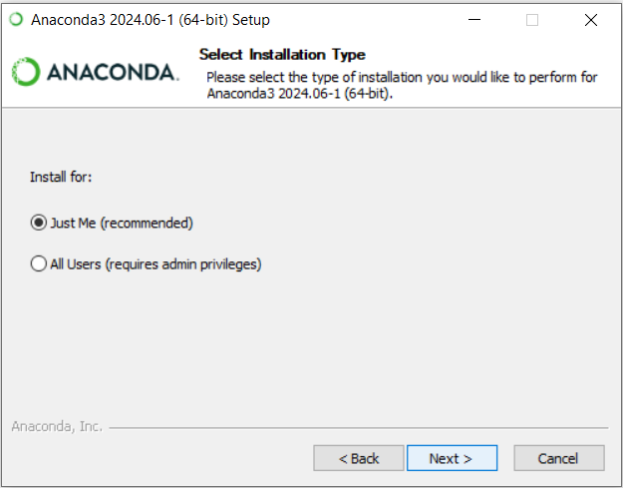

Slide 27
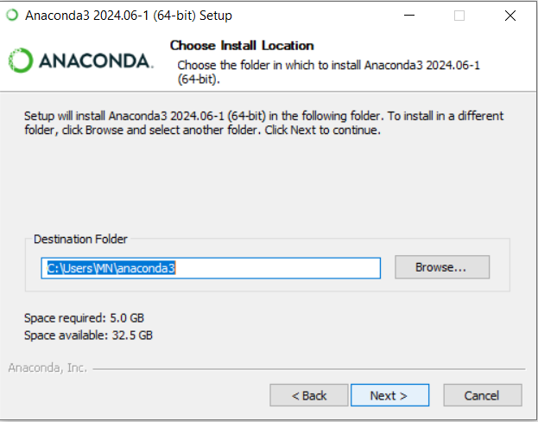
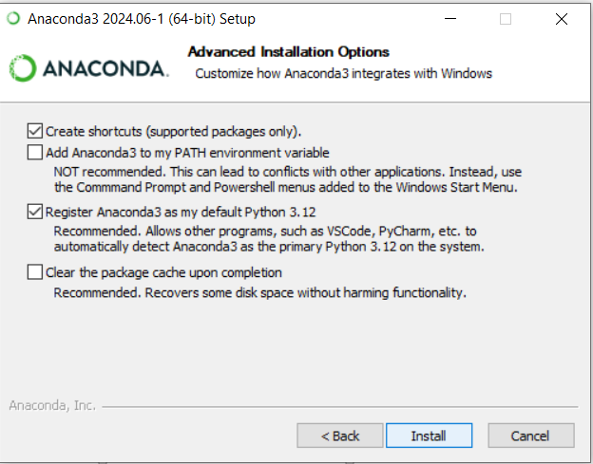

Slide 28
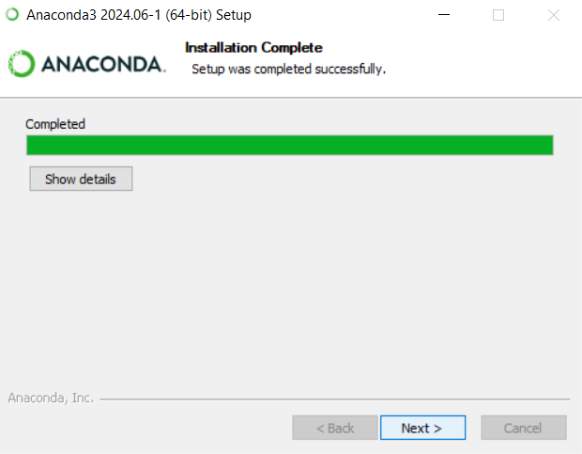
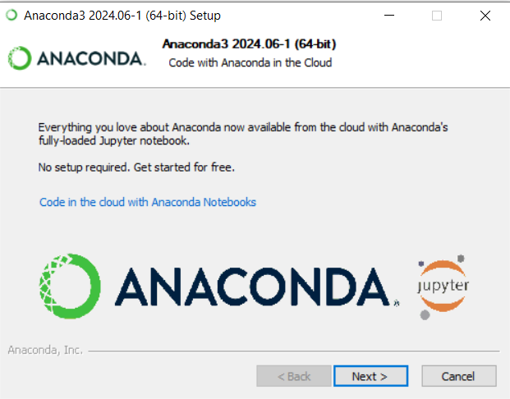
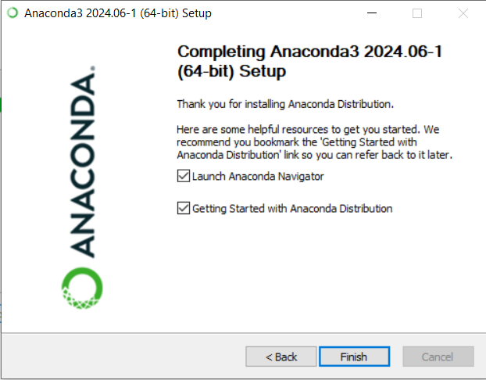

Slide 29
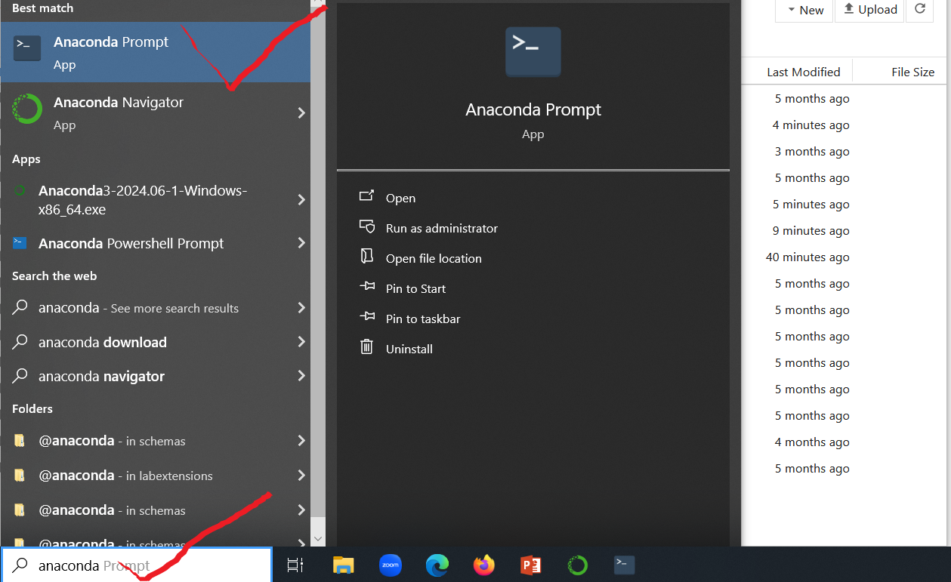

Slide 30
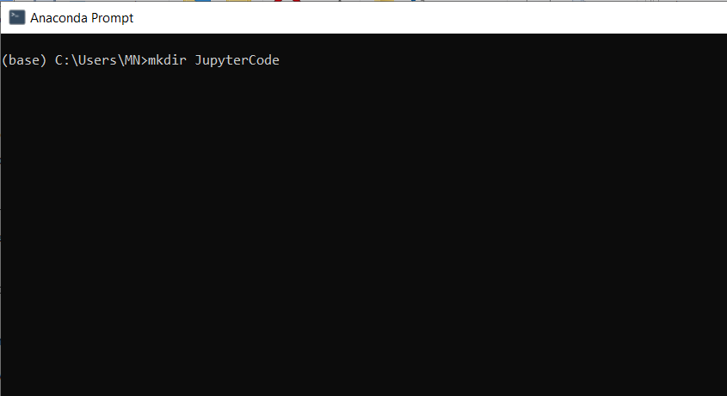
Create a folder “JupyterCode”
that we can save out python program

Slide 31
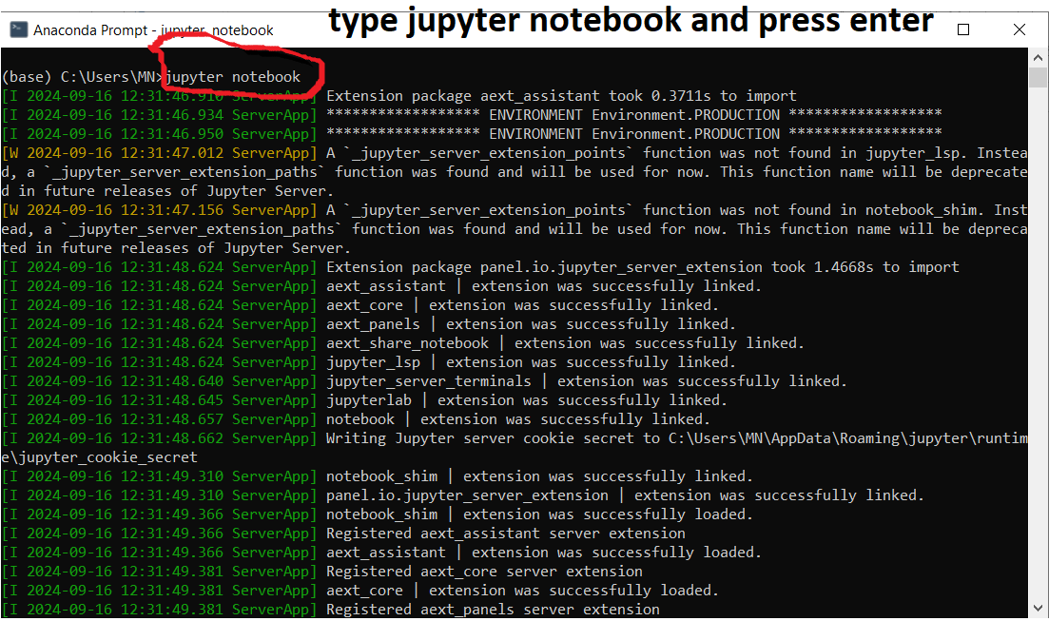
Into MN folder

Slide 32
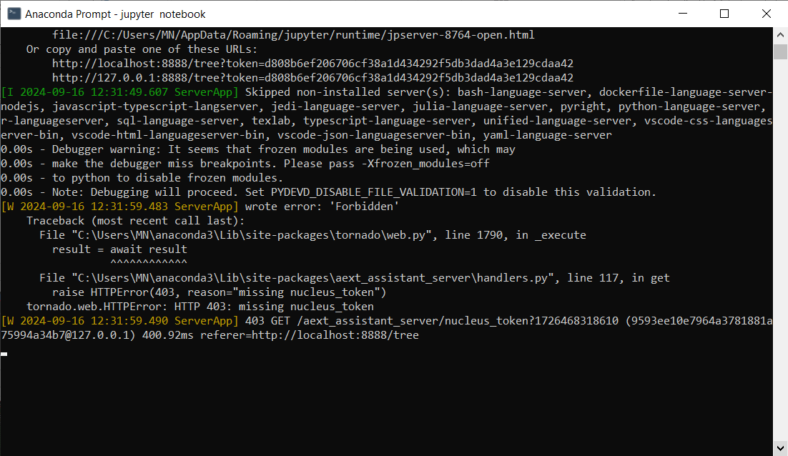

Slide 33
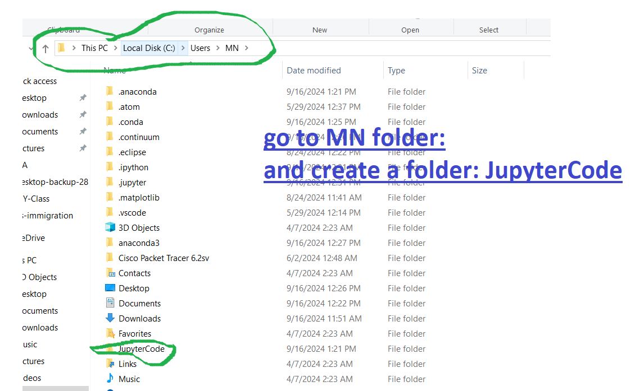

Slide 34
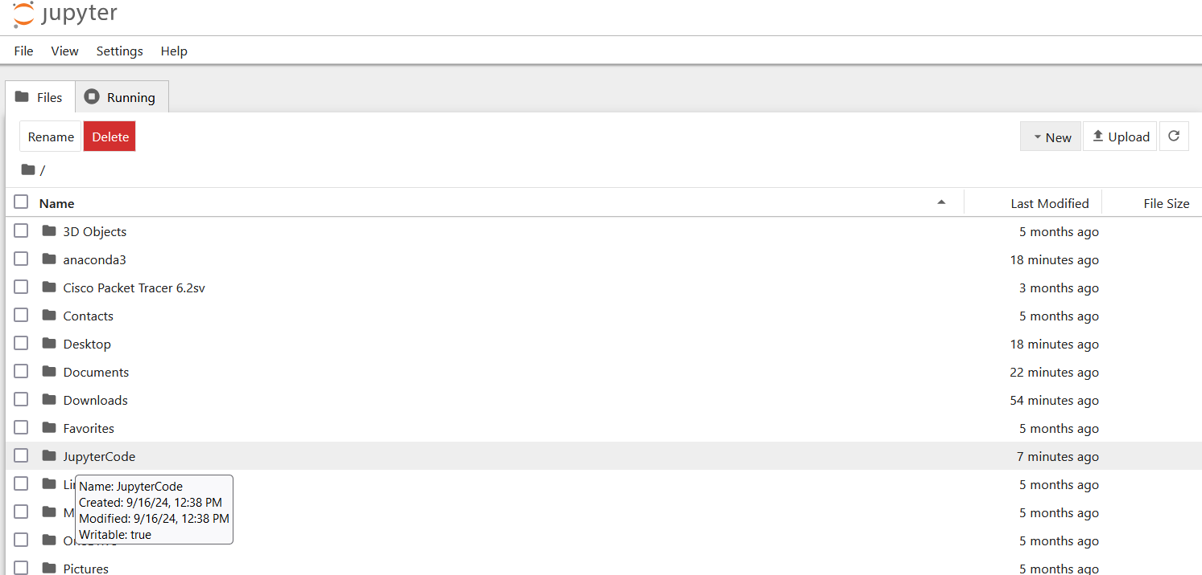

Slide 35
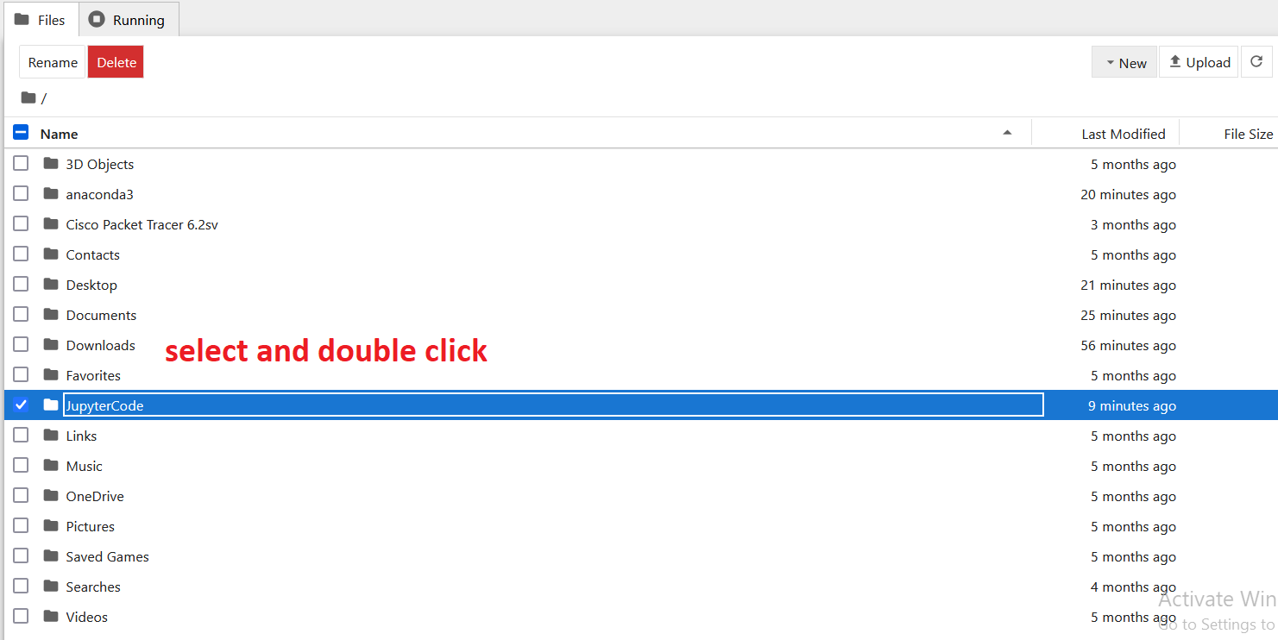

Slide 36
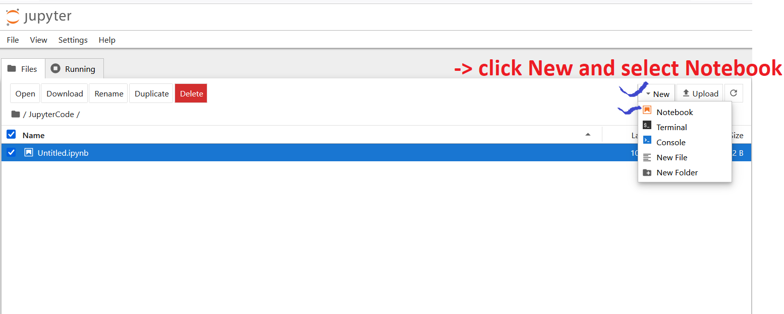

Slide 37
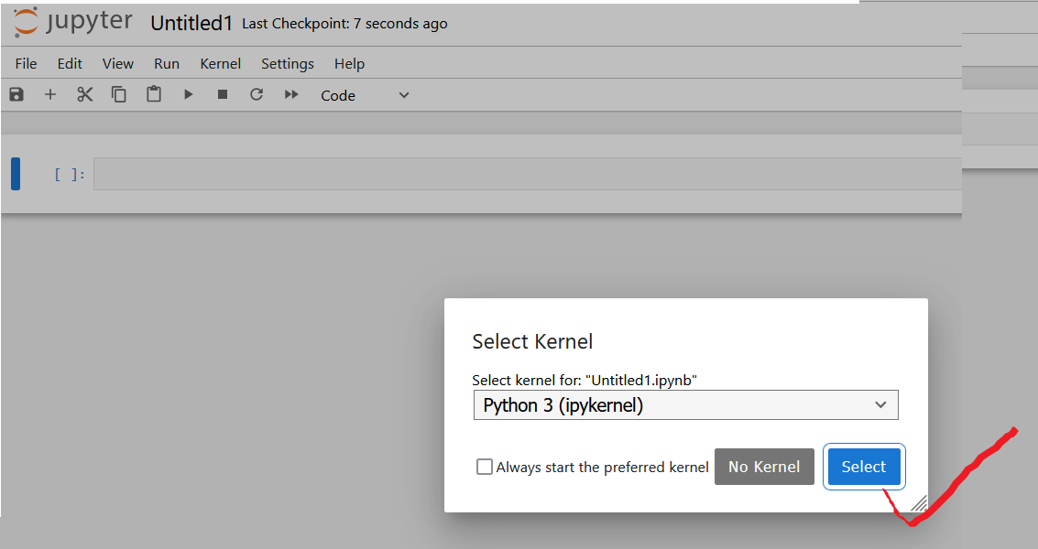

Slide 38
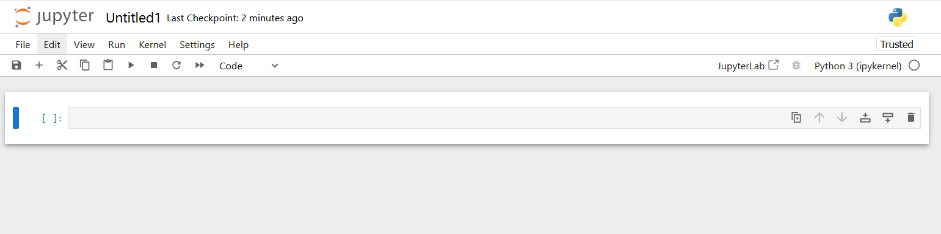
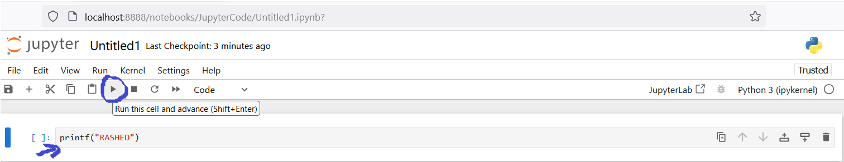
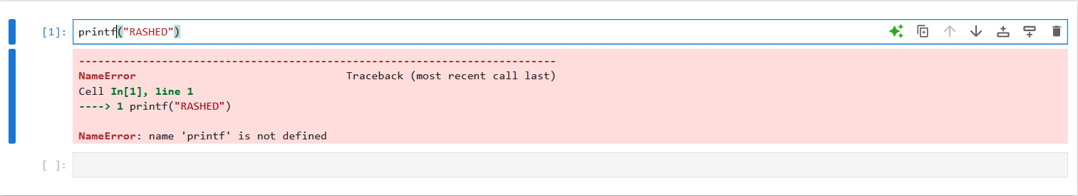

Slide 39
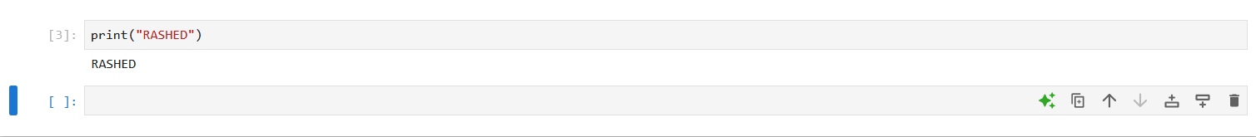
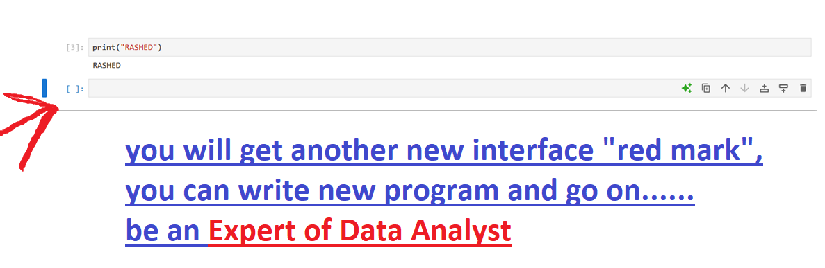
Output of our first program
Another important point

Slide 40
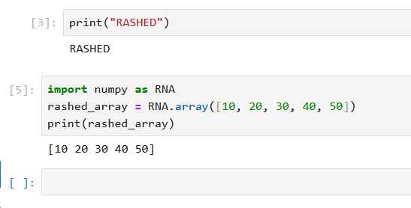
Numpy library:
→NumPy is a Python library
→NumPy is used for working with arrays
→NumPy is short for "Numerical Python"
https://www.w3schools.com/python/numpy/default.asp

Slide 41
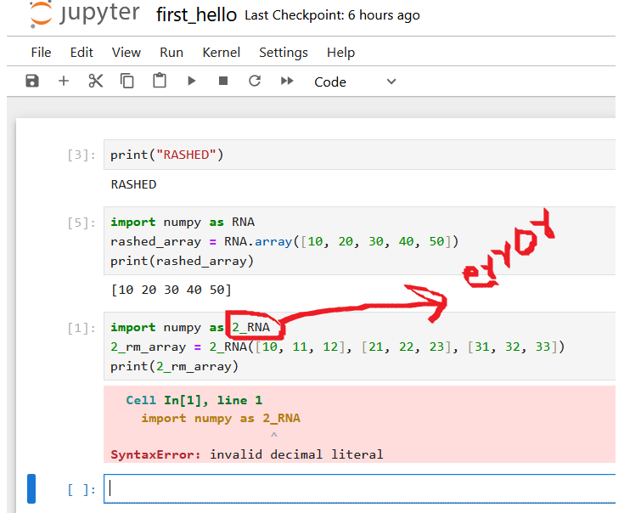
Is there any other errors?

Slide 42
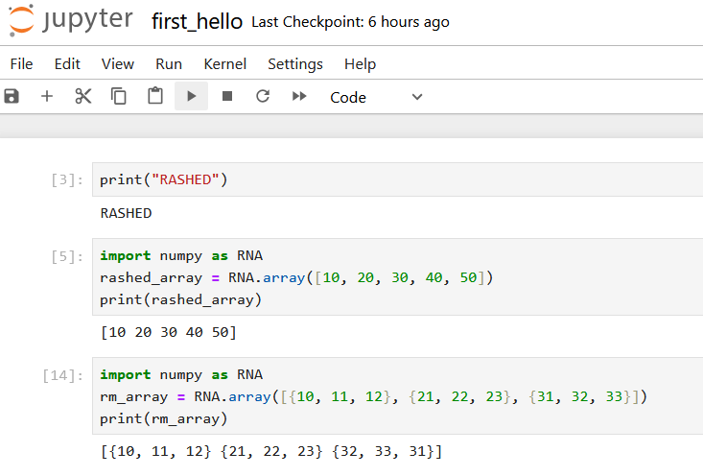

Slide 43
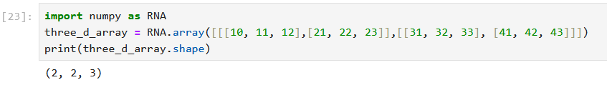
Find out the shape of the matrix

Slide 44
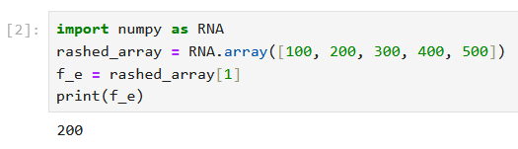
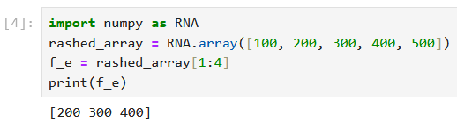

Slide 45

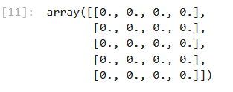
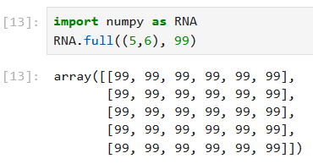
Problem-1
To create zero matrix
Problem-2

Slide 46
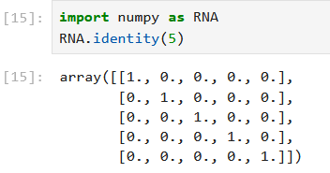
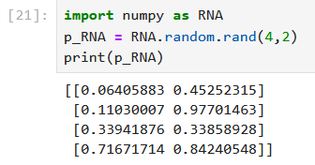
To create identity matrix
Reference. https://docs.python.org/3/library/random.html

Slide 47
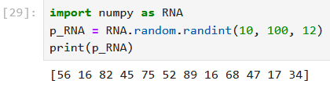
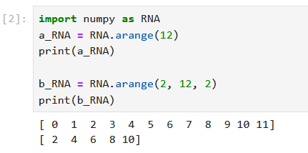
Reference. https://docs.python.org/3/library/random.html
Reference. https://www.geeksforgeeks.org/numpy-arrange-in-python/

Slide 48
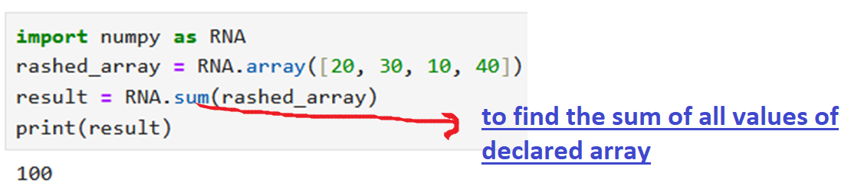
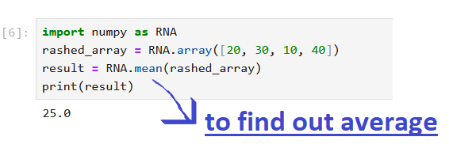

Slide 49
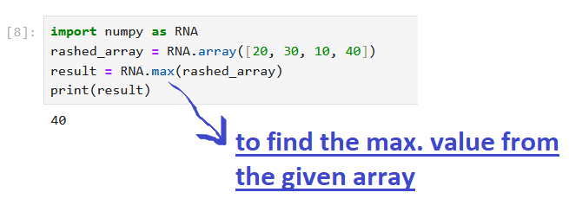
Do yourself to find the min. value from the given array
Find the array-index of the smallest number

Slide 50
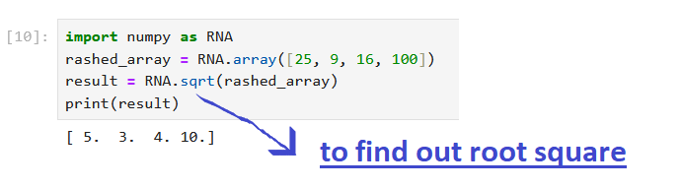
Find out sin, cosine, tan value

Slide 51
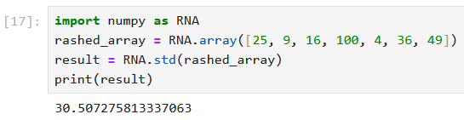
? ? ?

Slide 52
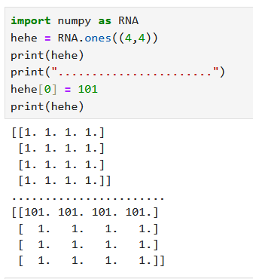

29/09/2024
Array arithmetic operation
→perform -, *, / by yourself
Broadcast Array: if ones to change more than one index value at a time

Slide 53

The genfromtxt() function is used to load data in a program from a text file. It takes multiple argument values to clean the data of the text file.
It also has the ability to deal with missing or null values through the processes of filtering, removing, and replacing.
The genfromtxt() function from the Numpy module is perfect for data loading and cleaning.
From text/notepad/wordpad file

Slide 54

Previous output type is float, hence convert into intger

Slide 55


Slide 56

From CSV
loadtxt library file has to be imported if you want to load data from csv file. After that “csv” file will be accessed using open() function.

Slide 57
What is Pandas?
→ Pandas is a Python library used for working with data sets
→ It has functions for analyzing, cleaning, exploring, and manipulating data
The name "Pandas" has a reference to both "Panel Data", and "Python
Data Analysis" and was created by Wes McKinney in 2008
Why Use Pandas?
Pandas allows us to analyze big data and make conclusions based on
statistical theories.
→ Pandas can clean messy data sets, and make them readable and relevant
Relevant data is very important in data science

Slide 58
What Can Pandas Do?
Pandas gives you answers about the data. Like:
→ Is there a correlation between two or more columns?
→ What is average value?
→ Max value?
Min value?
Pandas are also able to delete rows that are not relevant, or contains wrong values, like empty or NULL values. This is called cleaning the data.

Slide 59
Data Cleaning
Data cleaning means fixing bad data in your data set.
Bad data could be:
Empty cells
Data in wrong format
Wrong data
Duplicates

Slide 60


By default index
Customized
index

Slide 61


Slide 62



Slide 63



Slide 64


Slide 65

02/10/2024
Another way of dealing with empty cells is to insert a new value instead.
The fillna() method allows us to replace all empty cells with a value

Slide 66

If you want to specify any column

Slide 67

If you want to specify any column and mean value

Slide 68
Find median

Slide 69
Find mode

Slide 70

Try to find out wrong value and make correction

Slide 71

Try to find out wrong value and make correction
** based on certain condition

Slide 72

Drop the rows
Based on
Certain condition

Slide 73

Fill using
forward value

Slide 74
?
Fill using
backward value

Slide 75

Handling of Duplicates value
The duplicated() method returns a Boolean values
for each row
For example,
- Returns True for every row that is a duplicate,
otherwise False
# handling of duplicate value (current data set view)
import pandas as RPD
vovo = RPD.read_csv('panda_edit.csv')
print(vovo.head(40))

Slide 76


Slide 77



Slide 78

Plotting:
Pandas uses the plot()
method to create diagrams.

Slide 79

Plotting:
Pandas uses the plot()
scatter graph-> two columns based

Slide 80

Plotting:
Pandas uses the plot()
histogram:
based on single column

